Slide 1

You've Decided The Cloud Is Right For Your Organization.
Now The Hard Part.
@Reichental
February 14th, 2012

Slide 2
What we’ll cover today:
Flavors
Plan & prepare
Considerations

Slide 3
Let’s agree on what we mean when we discuss cloud computing.

Slide 4
Cloud computing is computing as a service.

Slide 5
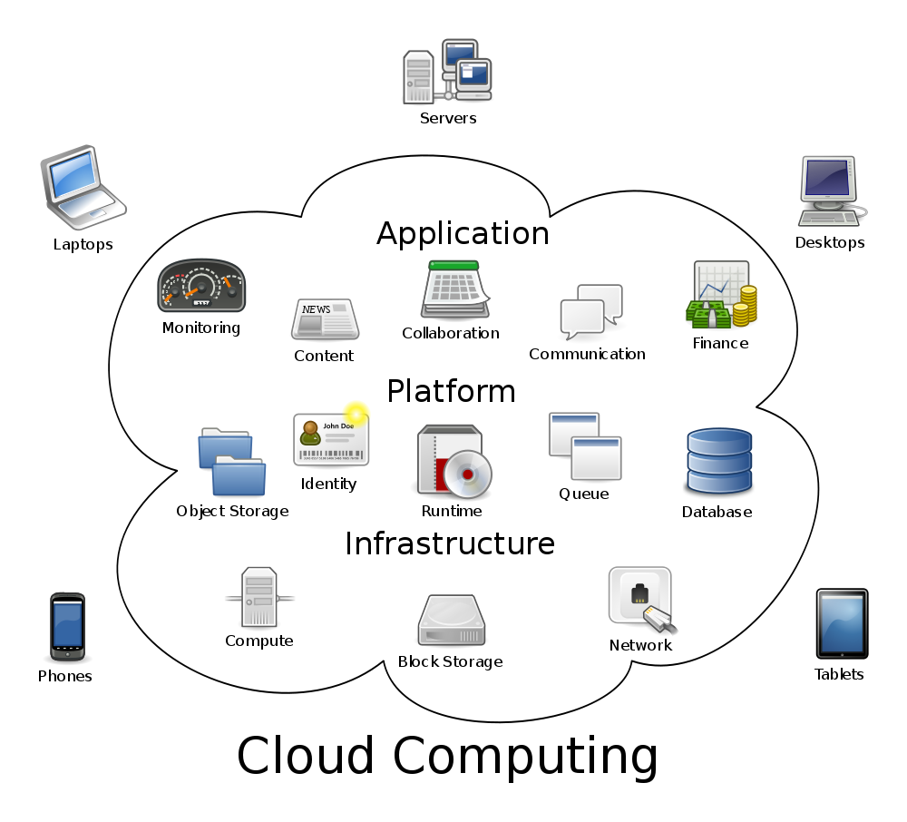
Image created by Sam Johnston

Slide 6
Do you BYOD?
Consumerization is a cloud driving force.
Notes:
26% don’t allow
24% allow but don’t support
Dropbox / Gmail / Evernote

Slide 7
Sure, cloud is an IT play.
But it’s much more than that.
Notes:
IT: Faster, cheaper, easier, scalable
BUSINESS: Extensible Enterprise

Slide 9
Lower cost.
Greater agility.

Slide 10
Do the math.
ON PREMISE
e.g.
Hardware
+ Application
+ Support
+ Upgrades
+ Maintenance
+ Backups
= TOTAL
CLOUD
e.g.
Subscription Fees
+ Interfaces
+ Support
+ Limitations
+ Loss of control
+ Downtime
= TOTAL
VS.

Slide 11

Start easy.
Gain confidence.

Slide 12
CLOUD
Sales
Marketing
HR
IT
Payroll
CORE
OUTSOURCE

Slide 13
CLOUD
Sales
Marketing
HR
IT
Payroll
CORE
Define Processes & Interfaces (Pre-automate if possible)
OUTSOURCE

Slide 14
Sales
CLOUD
Marketing
HR
IT
CORE
Payroll
OUTSOURCE

Slide 15
Sales
IT
CLOUD
Marketing
HR
IT
CORE
IT
Payroll
OUTSOURCE

Slide 16
Service
A
Service
B
Service
C
Service
D
Your Organization
Business XYZ

Slide 17
Service
A
Service
B
Service
C
Service
D
Service
C
Your Organization
Business XYZ

Slide 18


Case studies.

Slide 19
In this new world, the CIO (and others) can identify new business opportunities.

Slide 20
Bring the organization along together.
Notes:
Technical training.
Understanding options.

Slide 21
But what about risk?
Notes:
Liberate data
Integrity
Company goes bust

Slide 22
Summary.
Consumerization
Data Center ➔ New functions ➔ New opps
Start easy
Do the math
Weigh the risks
Componentize the business
Build new opportunities

Slide 23
Let’s continue the conversation @Reichental

